Slide 1
Agenda
Siskiyou County groundwater well application process guidelines
General review of draft ground water permitting guidelines
Presentation of public input from the GSA advisory groups
BOS discussion of GSA input issues/concerns
Legislation
Direction from the BOS

Slide 2
Background
Executive Orders (EO) N-7-22, N-3-23, and N-4-23 require counties across California to coordinate with Groundwater Sustainability Agencies (GSA) when reviewing and approving applications for wells that fall within the bounds of groundwater basins or subbasins subject to the Sustainable Groundwater Management Act (SGMA),
Groundwater Sustainability Plans (GSP’s)
Public Trust Doctrine ELF lawsuit

Slide 3
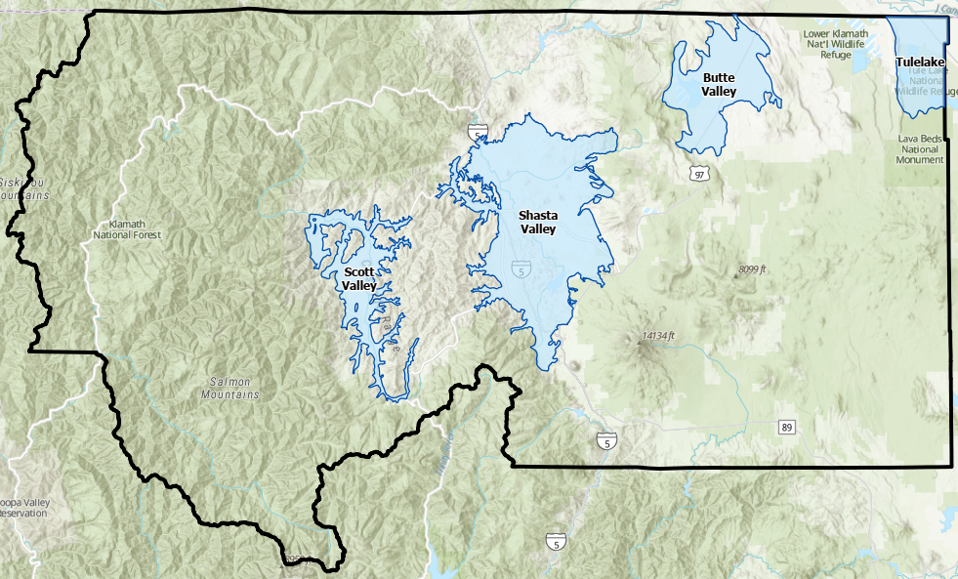
Siskiyou County Basins
Scott, Shasta, Butte Valley Basins
Siskiyou County Flood Control and Water Conservation District serves as the Groundwater Sustainability Agency (GSA)
Tulelake Basin
Siskiyou County Board of Supervisors serves as a member of the GSA for the Tulelake Subbasin alongside Tulelake Irrigation District, Modoc County, and the City of Tulelake

Slide 4
Groundwater well permit applications that are not subject to review.
Non-Production Wells (Ministerially issued/over the counter)
As defined by the Governor's order.
will provide less than two acre-feet per year of groundwater for individual domestic users,
or that will exclusively provide groundwater to public water supply systems.
    Are not subject to GSA review
    Are not subject to the Governor’s order
    Are subject to standardized Public Trust findings in the Shasta and Scott Valleys

Slide 5
Summary of determinations required prior to permit issuance for
(production wells)
Determine
Determine: that groundwater extraction by the proposed well would not be inconsistent with any sustainable groundwater management program (GSP) (9a Governor's order)
Determine
Determine: that extraction of groundwater from the proposed well is not likely to interfere with the production and functioning of existing nearby wells. (9b Governor's order) (all wells
Determine
Determine: the proposed well is not likely to cause subsidence that would adversely impact or damage nearby infrastructure. (9b Governor's order)(potential issue with-in the Tulelake basin)
Determine
Determine: if the obligation to consider the public trust and preserve public trust resources to the extent feasible applies and if so, whether appropriate findings have been made.

Slide 6
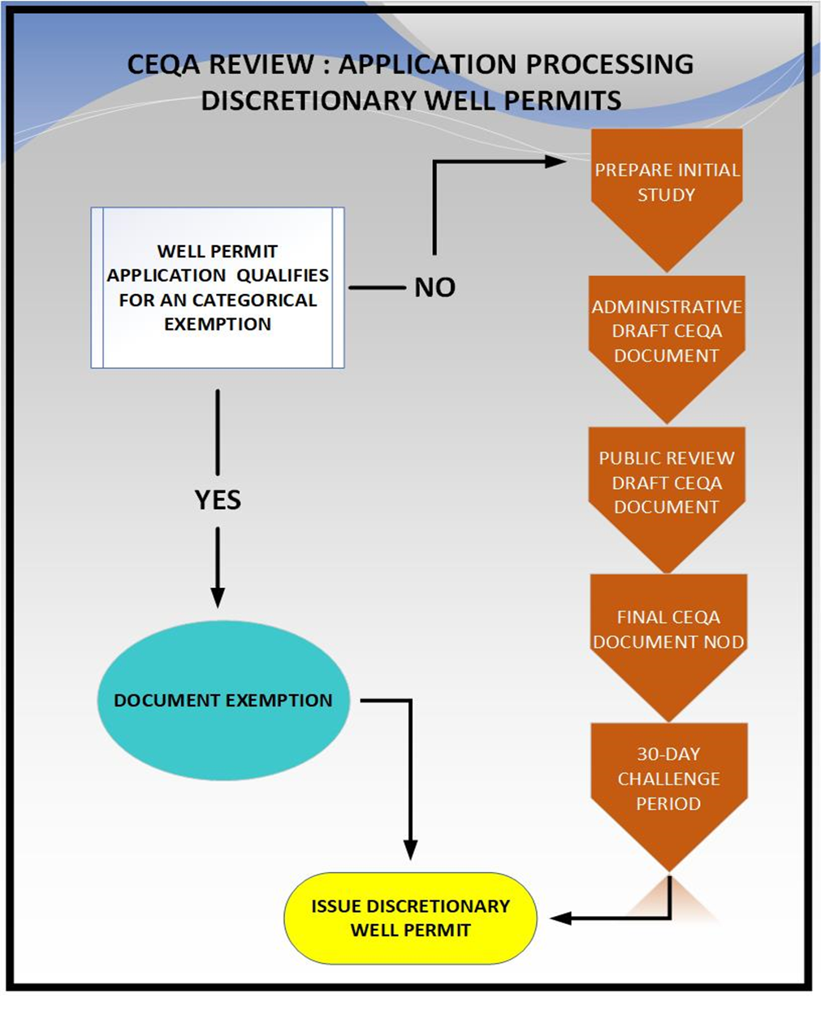
California Supreme Court addressed the circumstances under which a public agency may characterize the issuance of well construction permits as “ministerial,” and hence not subject to California Environmental Quality Act, versus “discretionary,” in which case CEQA applies.
Under CEQA, ministerial approvals are those that involve little or no discretion, merely apply a checklist or clear requirements to the facts as presented and are often issued over-the-counter by county staff. In contrast, discretionary approvals are those that involve judgment or deliberation, allow a county to use discretion to decide whether to issue the approvals and how best to shape or condition those approvals to avoid environmental issues and are often issued by an appointed or elected decision-making body.
CEQA review only applies to discretionary approvals.
DISCRETIONARY WELL PERMITS REQUIRE CEQA ANALYSIS

Slide 10
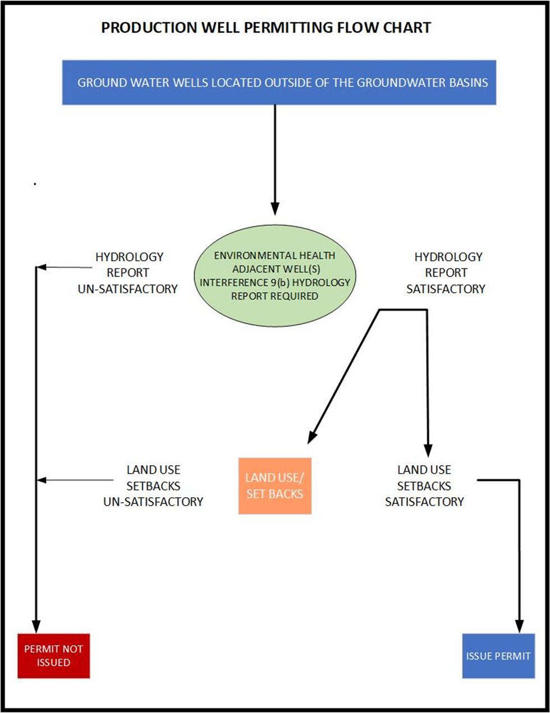

Slide 11
GSA / PUBLIC COMMITTEE DRAFT REVIEW
On February 7, 2023 Siskiyou County Department of Environmental Health presented to the Siskiyou County Board of Supervisors a draft groundwater production well permit review process.
BOS directed staff to present the draft well permitting guidelines to the GSA advisory groups and to seek input from each of the basin committees.
The Tulelake Subbasin Core Team met on March 24, 2023.
Scott Valley, Butte Valley, and Shasta Valley Groundwater Advisory Committees held discussions at their April 25, 26, and 27 meetings, respectively,

Slide 12
Summary of GSA/Public Comments of draft permitting guidelines.
Feedback from the three advisory committees, and Tulelake GSA ranged a variety of topics. Their comments are summarized below, sorted by topic. Discussion details have been documented in meeting summaries and made available online.
https://www.co.siskiyou.ca.us/naturalresources/page/sustainable-groundwater-management-act-sgma
The advisory committees expressed interest in reviewing the criteria again once it has been revised based on the feedback received before the process is adopted by the Siskiyou County Board of Supervisors.

Slide 13
TOPIC: GENERAL IMPRESSIONS – GENERAL COMMENTS
It was recommended that the County build in as many exemptions as possible for the wells that aren’t likely to have as much of an impact and save the time and resource-intensive evaluations for the wells that are at a higher risk of impacting groundwater supplies.
There is an opportunity to create a well permitting process that is flexible enough to allow for conjunctive use, and thereby leverage other goals in the GSPs like addressing surface water depletion. For example, drilling a new groundwater well to replace a well that was contributing to surface water depletion would be an overall improvement for groundwater conditions.
It was acknowledged that this process would help to prevent situations where shallower wells go dry as a result of newer, deeper wells being drilled by neighbors. This process could help prevent the “race to the bottom” mindset. Ultimately, it may prove useful for the basins to have this process in place, even without the Executive Order mandates, if it helps achieve long-term sustainability.

Slide 14
Discussion
It is the intent to maximize ministerial permitting
Further develop zero net consumptive uses matrix for production wells.
Further expand ministerial permitting by way of the program EIR process to developed mitigation options such well seal depth and establish zones with designated separation distances from adjacent wells.
Via program EIR, Identifying County wide public trust review area (PTRA), wells outside the PTRA would not be subject to Public Trust doctrine review.
Flexibility allow conjunctive use Idea of combining use of both surface water and groundwater for betterment.
Use to “Keep Basin in Check”.

Slide 15
Ministerial Well Permitting Class Definitions (Draft example)
WELL CLASS | DESCRIPTION
Low water Use Well | Well for Low Water Use. A water well where total groundwater use of the parcel is limited to 2.0-acre feet or less per year.
Public Water Well | Public Water Well. A public water well for which environmental review under the California Environmental Quality Act is complete.
Zero Net Increase Well | Net Zero Groundwater Increase. Water well, where the proposed use would not result in a net increase in groundwater use from the local aquifer through implementation of water conservation measures, rainwater catchment or recycled water reuse system, water recharge project, agricultural practices that increase infiltration and soil moisture capacity, or local groundwater management project. Subject to Governors order parts 9(a) and 9(b).
Adjudicated Water Right Water Board Regulated | Surface Water Diversion Well. A water well that serves as a point of surface water diversion for an appropriative water right regulated by the California State Water Resources Control Board, Division of Water Rights. Decree or adjudication.
Existing Use New or replacement/ emergency replacement Well | Well for Existing Use. A water well where total groundwater use of the parcel is limited to and does not exceed the amount of groundwater used as adoption for legally established land uses. Location shall be no closer to the nearest stream compared with the existing well.
Injection | Injection Well. A well that is used solely for injecting water into the underground.
Monitoring | For observation and data collection

Slide 16
TOPIC: Replacement, Repair, or Alteration of Existing Wells
There is not a clear pathway for well owners who want to replace or modify an existing well.
  Would CEQA be involved? If so, could the County submit a Programmatic EIR to cover all wells?
County should consider including an exemption or expedited approval process for:
  Emergency well replacements, particularly in cases where the well is the sole source of water
  Replacement wells that are drilled in the same location and don’t change the production capacity
  Replacement or alternative wells that are drilled in a different location to increase efficiency, but not yield

Slide 17
Discussion
Path to replace or modify a well. Replacing like for like, not a problem provided original well is destroyed. Modification of a well depends on whether the modification will lead to increased consumptive use.
Yes, CEQA is involved any time discretionary decisions are made such as implementing a mitigation to cause effect.
Emergency replacement wells or wells drilled in the same location or adjacent to the existing that is being destroyed. Provided that there is no additional consumptive use, well permitting could be done ministerially
Replacement wells drilled in another location like for like i.e. depth and diameter could be ministerially issued again provided original well is destroyed.
Subject to Governor’s order review process

Slide 18
TOPIC: CERTIFIED HYDROGEOLOGIST (CHG) REQUIREMENT
Given the complexity of the local hydrogeology, there were concerns shared across multiple basins that no certified hydrogeologist (CHG) would be able to conduct the evaluations. This is mostly due to a lack of certified CHGs available in the County.
Additional concerns were shared that CHGs would not want to subject themselves to the liability associated with signing off on the evaluations.
Hiring CHGs is expensive. There was discussion on the possibility that the County would hire a CHG to conduct the evaluations, and this cost would be passed on to the applicant are part of the permitting process. Ultimately no recommendations were made. It was suggested that State resources could assist with the CHG requirement.
Are there ways to challenge determinations that are made by a CHG?
The County should investigate whether it would be acceptable for a geologist to perform the evaluation, since there are more certified geologists than hydrogeologists available in the County.

Slide 19
Discussion
Concerns revolving around utilizing a certified hydrogeologist to evaluate impacts. Agreed that this is problematic and noted. Cost, availability, and evaluation methodology consistency.
Should an applicant choose to hire their own professional, the GSA and County would still need to conduct their own evaluation and those costs would be passed on to the applicant.
Potential alternative is to establish zones for setback requirements through a program EIR - CEQA.
Geologist vs hydrogeologist
Pending legislation AB 1563: 13807 water code (2) (A) The permit applicant has provided the permitting agency a written report prepared by a licensed professional that indicates that the extraction by the proposed well is not likely to interfere with the production and functioning of one or more existing nearby wells and is not likely to cause subsidence that would adversely impact or damage nearby infrastructure.

Slide 20
SHORTFALLS OF THE PROCESS,
ESPECIALLY REGARDING LARGE RESIDENTIAL GROUNDWATER USE
The County’s process doesn’t address the following issues:
  Groundwater wells that are drilled without permits.
  Domestic wells that pump water for illegal marijuana grows.
  Domestic wells that pump more than 2 acre-feet per year.
  New residential developments that are sourced by domestic wells.
There was a desire for the process to be flexible enough to address emerging concerns associated with increased residential pumping, particularly in Shasta Valley. The potential impacts from increased use of groundwater wells for residential subdivisions may overtake impacts from increased irrigated agriculture (since those lands are more built-out). Subdivisions are different from rural domestic wells and the County should treat them differently. The ordinance should not grant blanket approval of domestic wells.

Slide 21
Discussion
Code enforcement addresses non permitted drilled wells. SO and code enforcement actively pursue cannabis cultivation violations with resources at hand. Which includes citing fines for on-site wells that contribute to the grows.
Domestic wells subdivisions “County should not grant blanket approval for domestic wells! Rural domestic wells vs Subdivision domestic wells.
  Zoned density standards met.
  Domestic well recharge.

Slide 22
Topic: role of technology in assessment
There was great interest from the Advisory Committee Members in using the groundwater model to evaluate the impacts of new wells. The model can also evaluate multiple components, including public trust doctrine. There would still be costs for applicants if they use the model to run the analyses, but it would likely be cheaper than hiring a CHG.
  It was noted that the Shasta Valley, Scott Valley, and Butte Valley groundwater models are at different levels of completeness. Advisory Committee members noted that the Shasta Valley groundwater model updates would need to be in place before the model could be used as a tool to evaluate new wells.
Satellite imagery can also help to confirm that consumptive use isn’t increasing, which should make requests for replacement wells for the same capacity and same acreage more straightforward to approve.
The permitting process should be informed by water supply conditions.
Once more data is acquired, the basins can evaluate the extent to which increased pumping is sustainable.

Slide 23
Discussion
Use of Technology can be integrated for monitoring and well permit application review to support goals of the GSP’s
Status of basin GSP’s
Data collection may be improved with technology. Resource conditions are dynamic and will influence decision making over time.

Slide 24
Legislation and Litigation
Proposed legislation AB 1563 basically mirrors the current Governor's order
Amendment to water code section 10726.4
(a) Gives authority to the GSA –who- may regulate groundwater extraction using that authority.
(b) Does not authorize GSA to issue permits Requires Environmental Health to forward permit requests for well construction for new wells, enlarging of existing wells and reactivation of abandoned wells to the GSA prior to permit approval
Article 5. Water Wells State water code
13807.
(a) In addition to meeting the other requirements of this chapter, a county, city, or any other water well permitting agency shall not approve a permit for a new groundwater well or for alteration of an existing well in a basin subject to the Sustainable Groundwater Management Act (Part 2.74 (commencing with Section 10720) of Division 6) and classified as a critically over-drafted basin unless all of the following conditions are met:
Includes requirement to utilize a licensed professional.

Slide 25
BOS Direction /Discussion
GSA’s overwhelming majority is against having an indemnification agreement.
Licensed professional requirement for all wells is impractical.
Parameters of Program EIR
Wishes considering pending legislation.

